Slide 1
Hi-C data analysis
Nezar Abdennur
PhD Candidate in Computational and Systems Biology
Mirny lab, MIT
ISMB/ECCB 2017

Slide 2
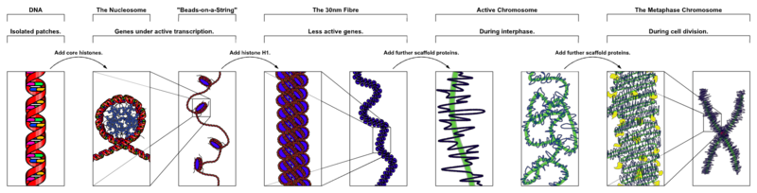
3D Genome Organization
DNA is locally compacted using histone octamers to form nucleosomes
DNA is globally compacted by way of chromosomes (during mitosis, cell division, etc)
Intermediate packaging mechanisms are subject of heavy speculation
??? ??? ??? ??? ???

Slide 3
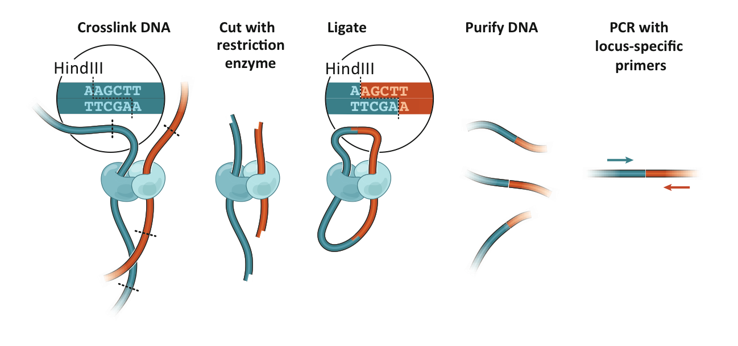
3C: Chromosome Conformation Capture
Detects physical interactions between genomic elements
Interacting elements are converted into ligation products
Detect ligation events by probing for them:
3C: one by one (PCR)
4C: one by all (microarray or seq)
5C: many by many (microarray or seq)
in intact cells
Dekker et al. Science 2002
Dostie et al. Genome Res. 2006
Notes:
Each locus in a (karyotypically normal) cell has n=2 possible interactions that can be measured.

Slide 4
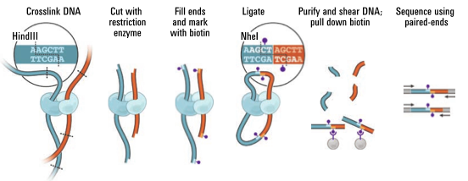
Hi-C: Genome-wide 3C
Selectively purify “ligation junctions” from sheared, size-selected DNA
Add adapters and do paired-end sequencing
Lieberman-Aiden, van Berkum et al. Science 2009

Slide 5
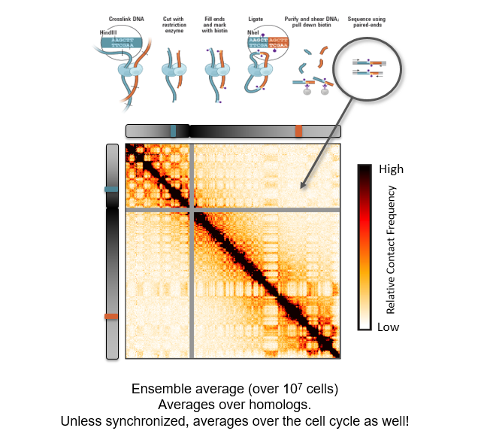
Hi-C: Genome-wide 3C

Slide 6
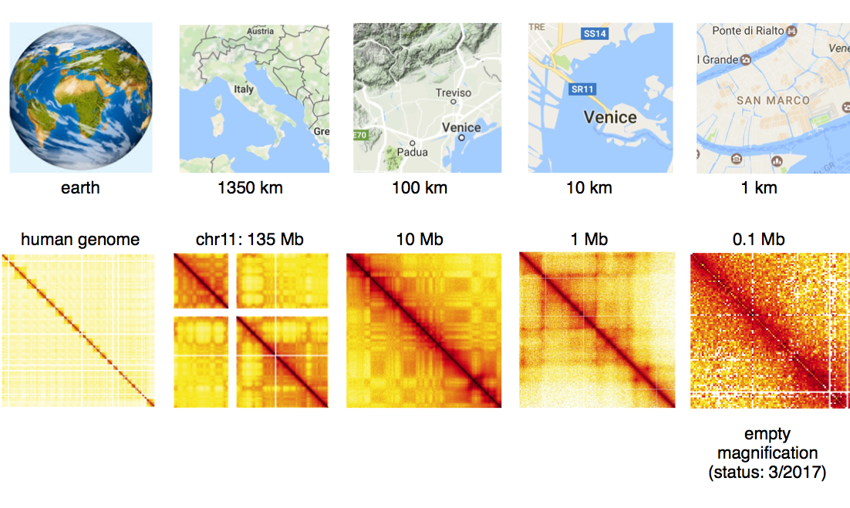
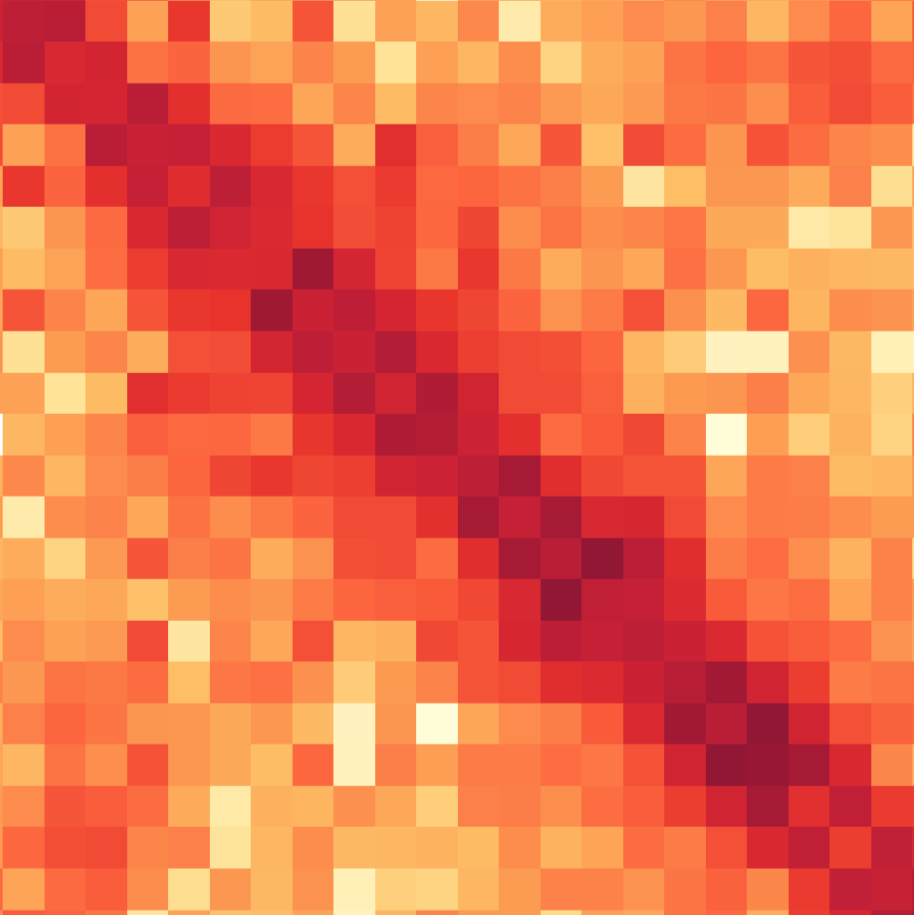
Dynamic range of Hi-C data
http://bit.ly/2tkQoDn
c/o Johannes Neubler

Slide 7
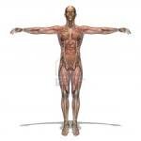
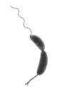
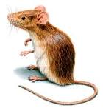

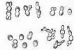
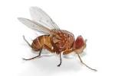
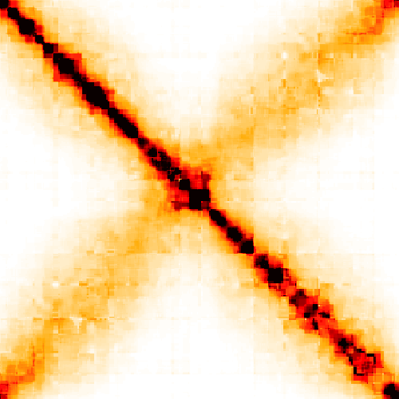
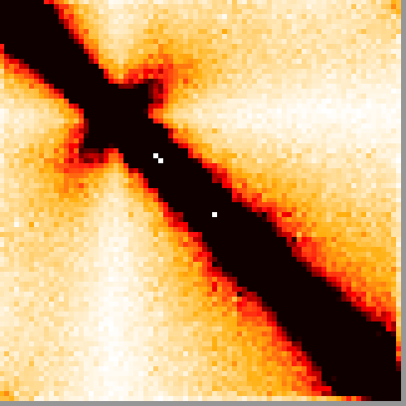
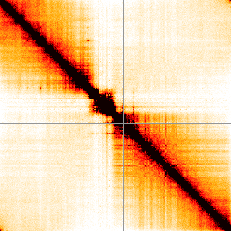
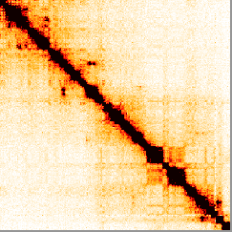
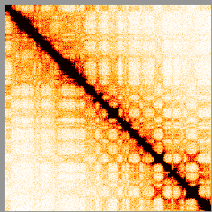
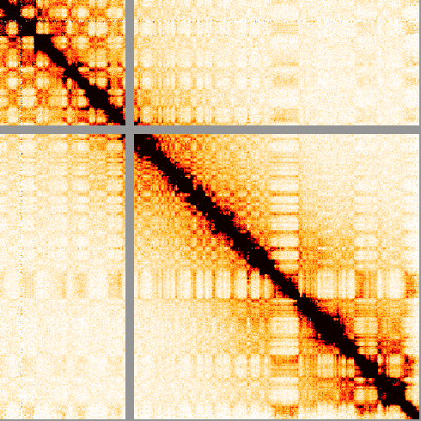
Genome organization across kingdoms
C. crescentus
S. cerevisiae
A. thaliana
D. melanogaster
M. musculus
H. sapiens
4 Mb
12 Mb
157 Mb
180 Mb
2.7 Gb
3 Gb
Bacteria
Fungi
Plants
Insects
Mammals
Notes:
Exciting field, since Hi-C technology is being applied to an ever-growing number of organisms.
I also study folding in yeast, but in this talk I’ll focus on humans.
First I’ll discuss known principles of interphase chromosome organizaiton & then I’ll talk about some unpublished work in metaphase.

Slide 8
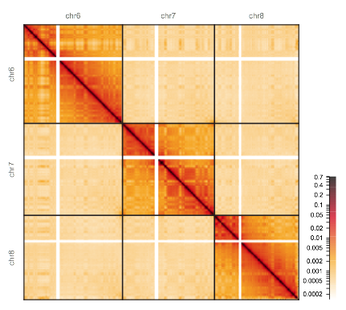
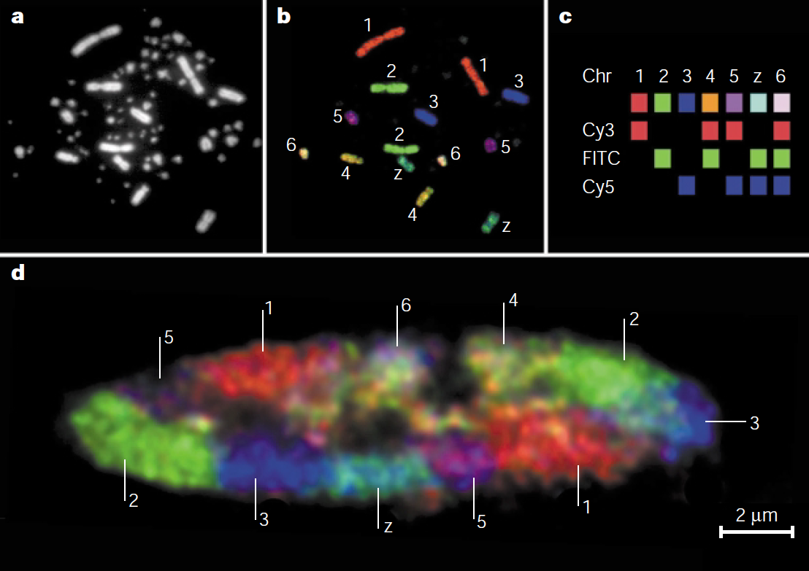
Territoriality
cis
trans
Cremer & Cremer, Nature Review Genetics (2001)

Slide 9
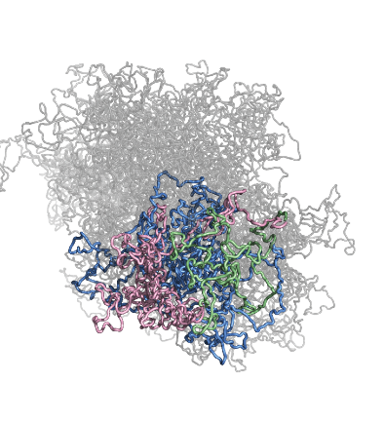
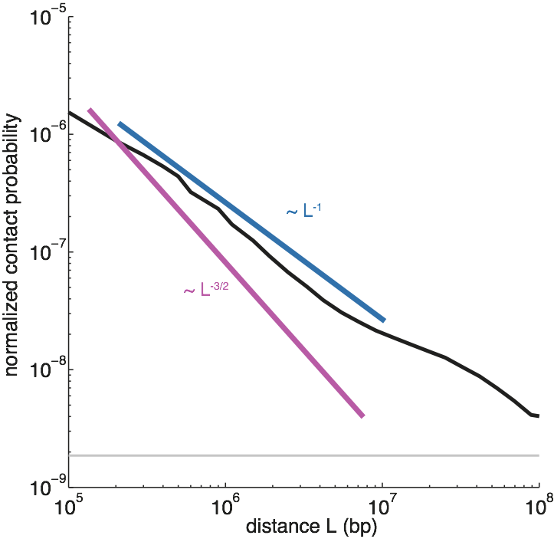
Polymer nature
100-fold difference!
Characteristic decay of contact probability as a function of linear genomic separation within chromosome arms.

Slide 10

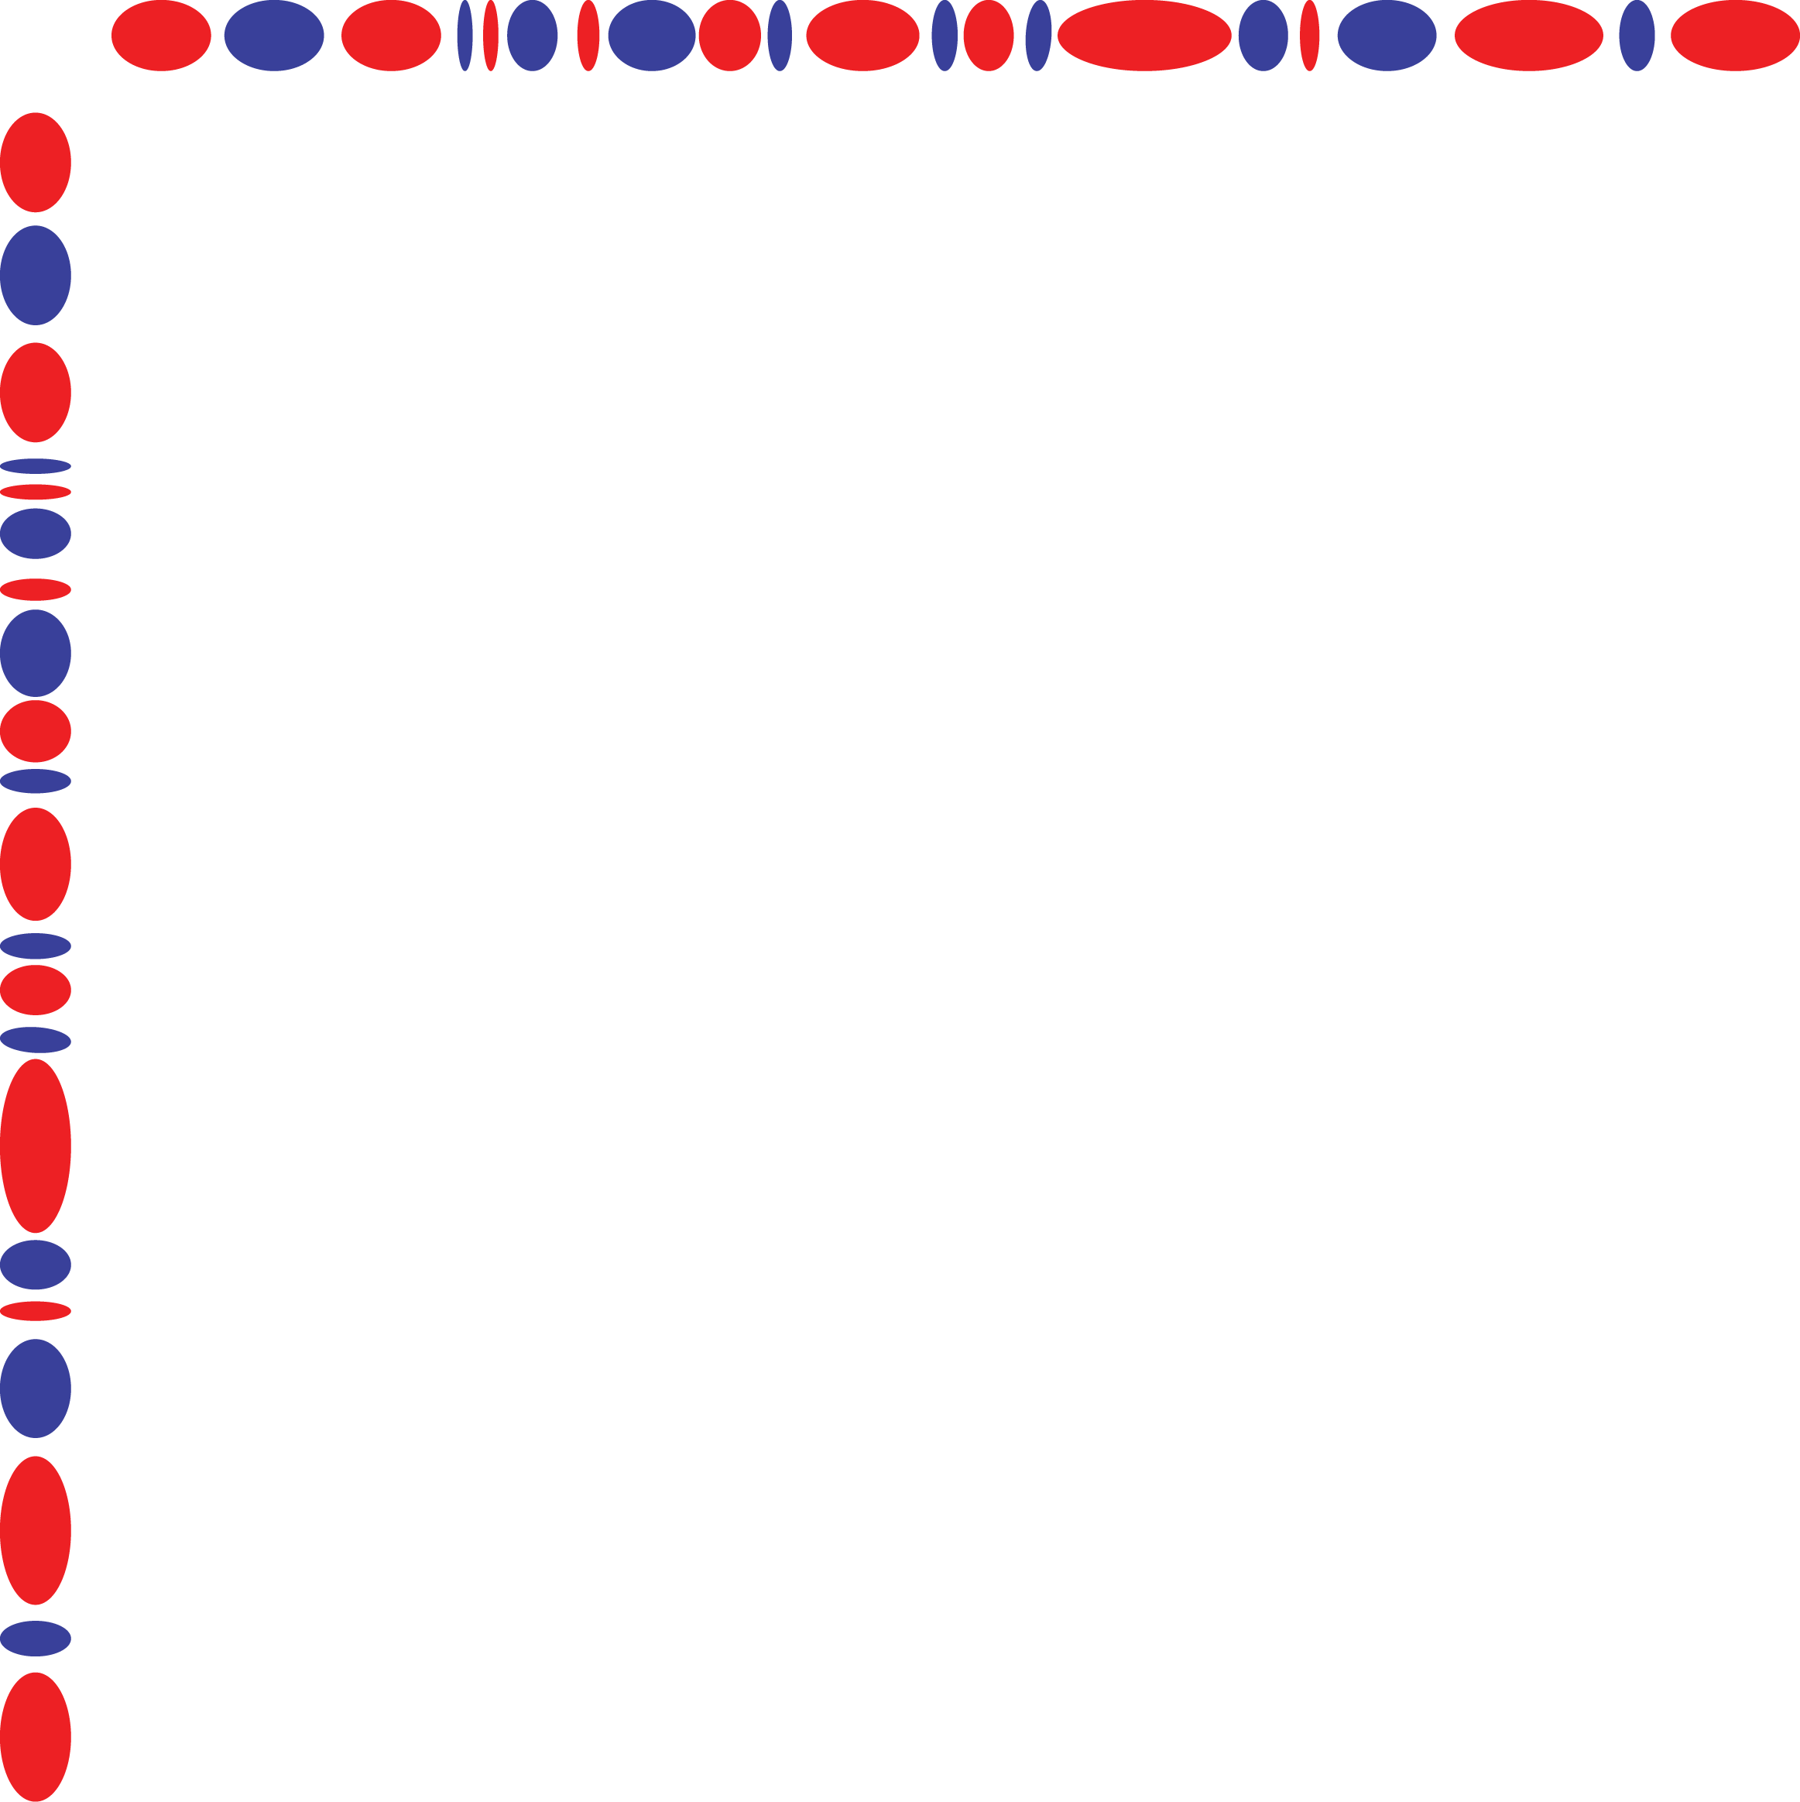
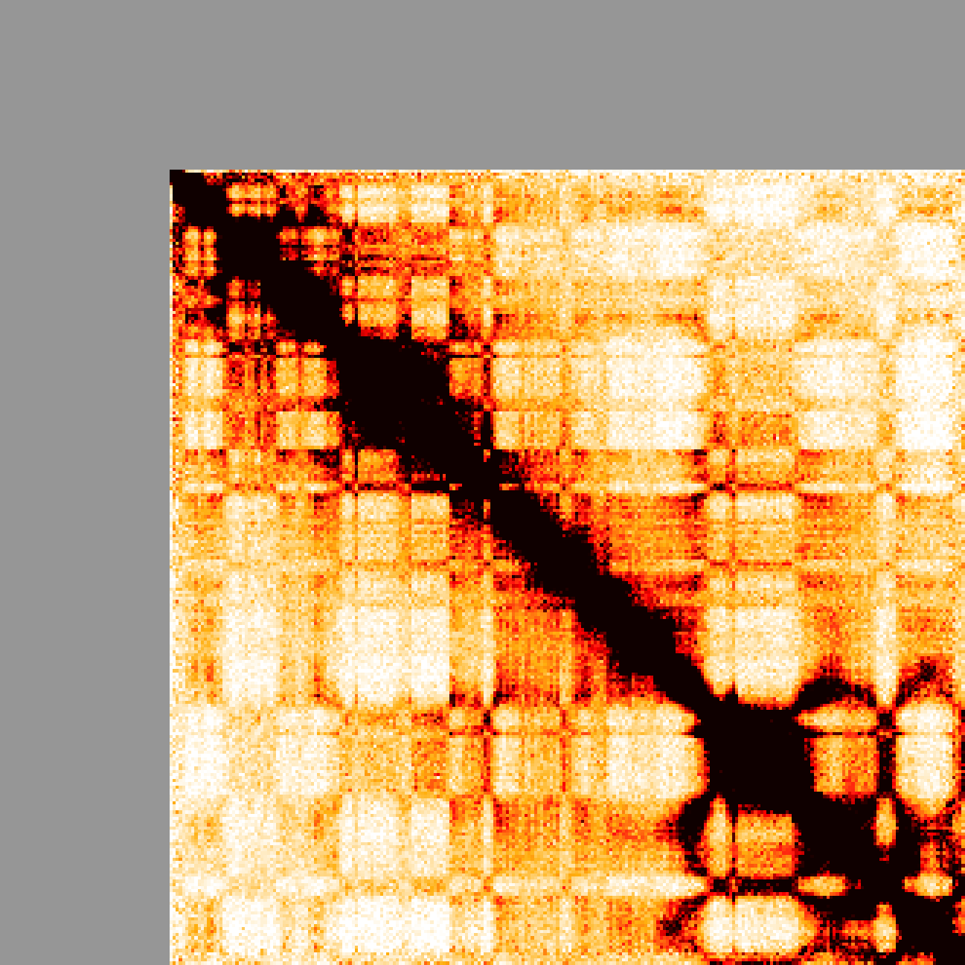
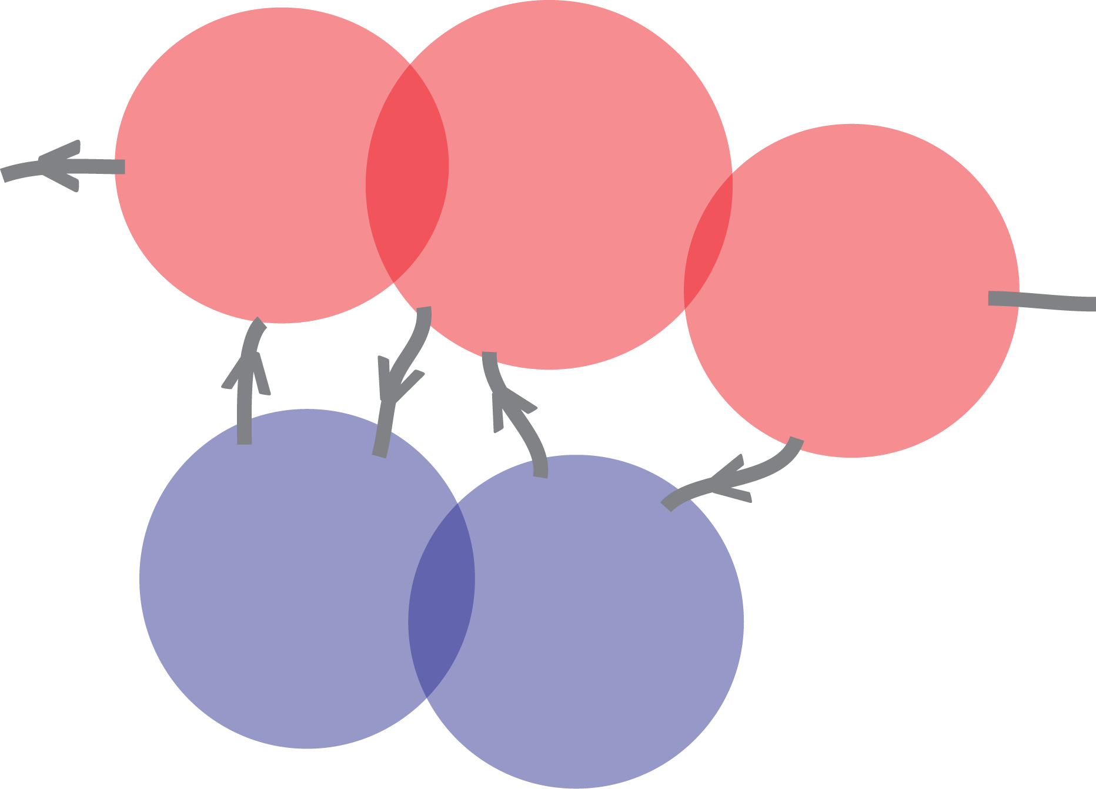
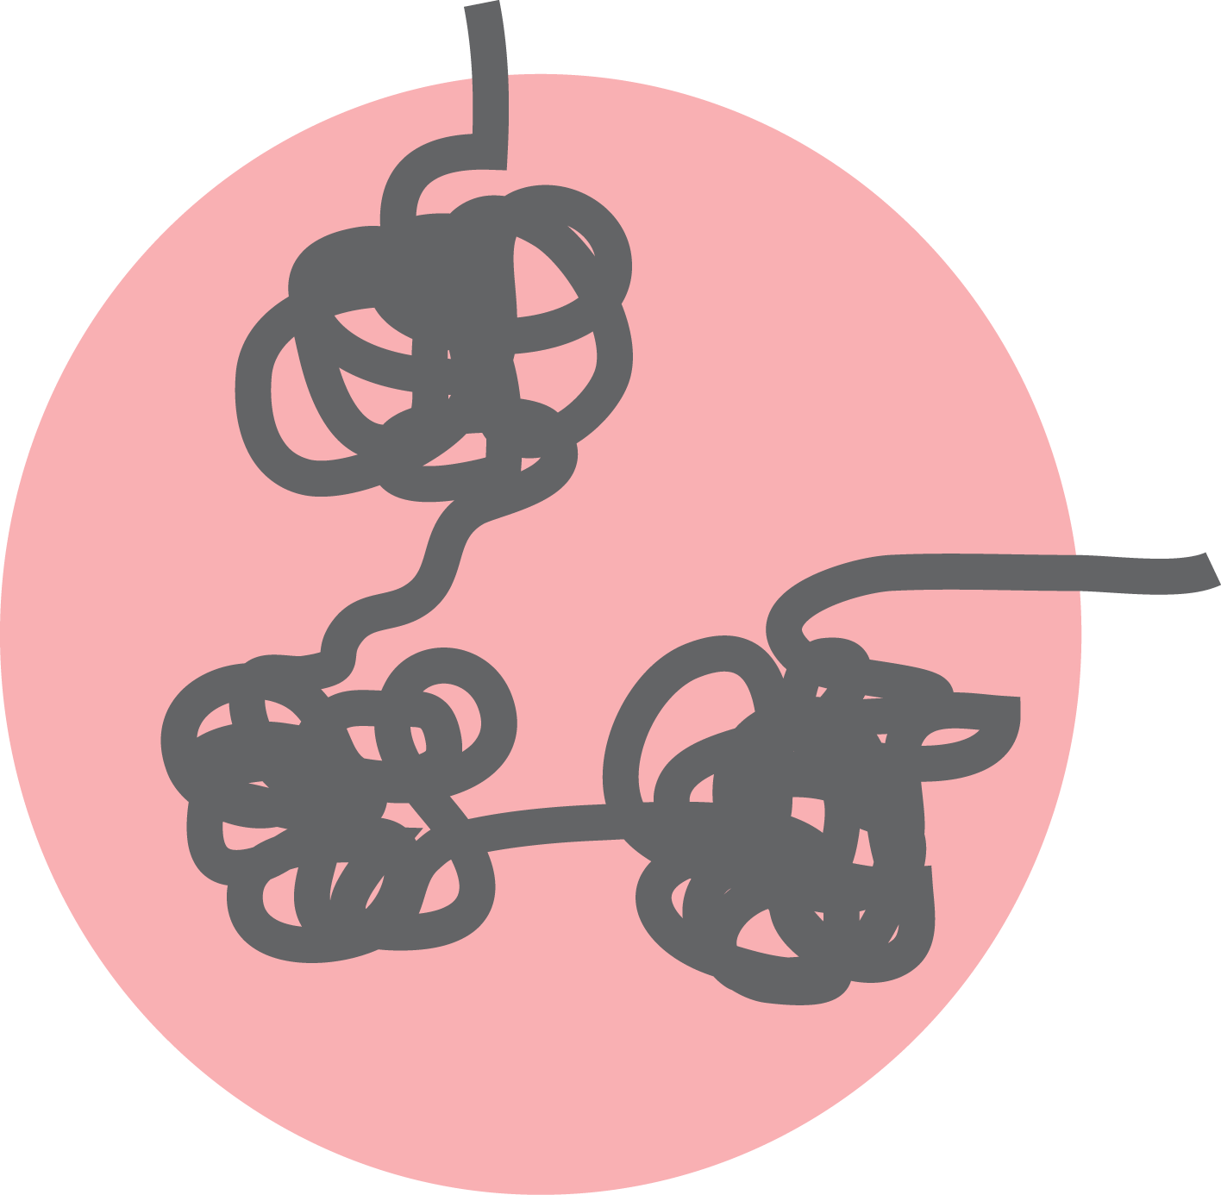
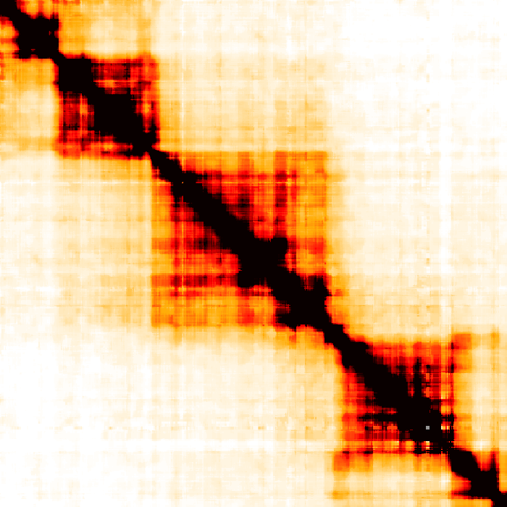
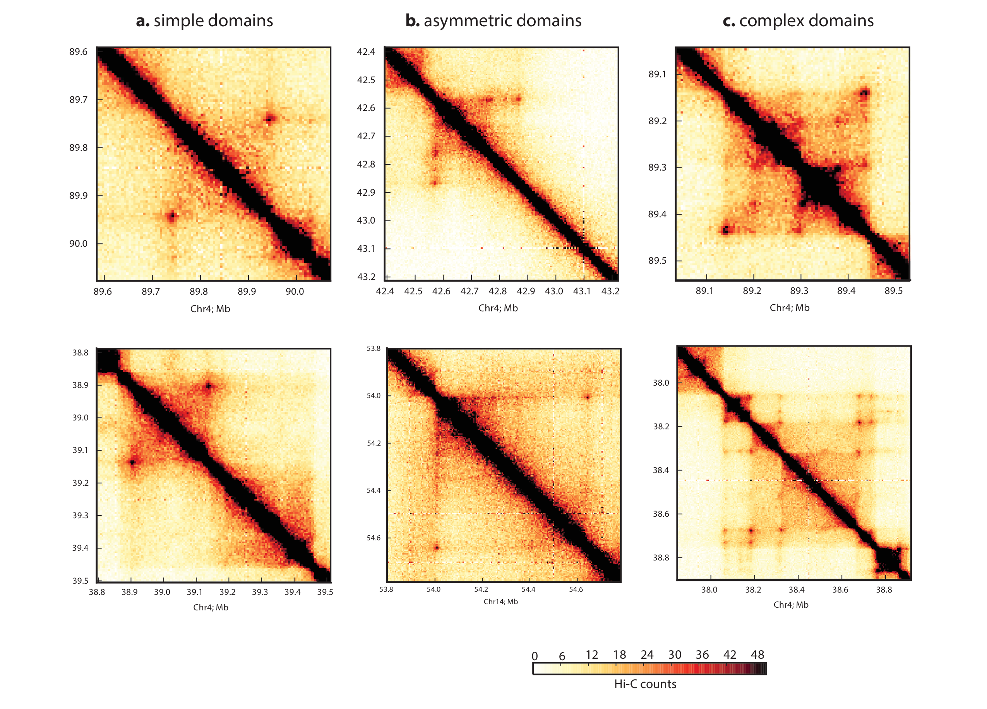
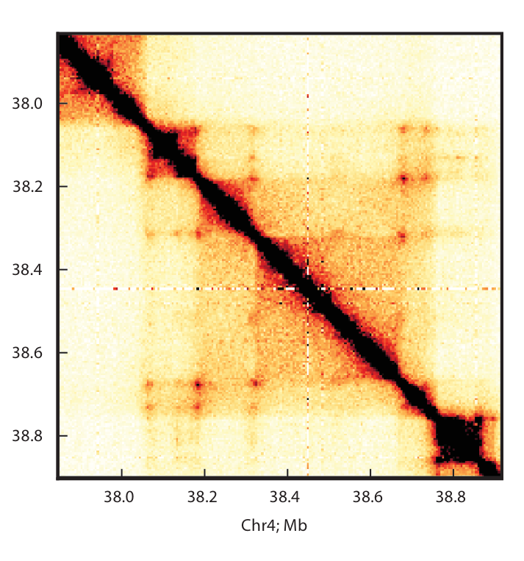
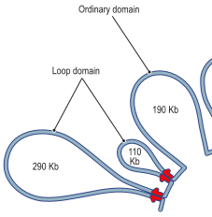
Organizational patterns in interphase
Pattern
Interpretation
Inactive
Checkerboard/plaid
A/B compartments
(Lieberman-Aiden et al, 2009)
Active
chr14
106 Mb
Dense squares
TADs
(Nora et al, 2012
Dixon et al, 2012)
0.1-1 Mb
Corner peaks
Loops
(Rao et al, 2014)
0.1-1 Mb
Notes:
In metazoans, specifically.
I’ll use the word domain loosely to refer to domains and loops…
Population aggregation
Scaling
Compartments
TADs
Loops
Ideal chain
TADs (lower resolution) are remarkably robust (The unstated conclusion of all Bing Ren papers)
Conserved across syntenic regions (also supported by Hadjur paper w/ conserved CTCF motifs)
Robust to differentiation and TNF-alpha treatment
Positioning of TADs doesn’t change
Morphology inside TADs change

Slide 11
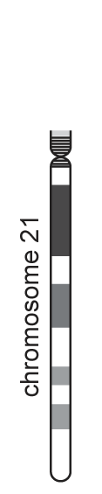
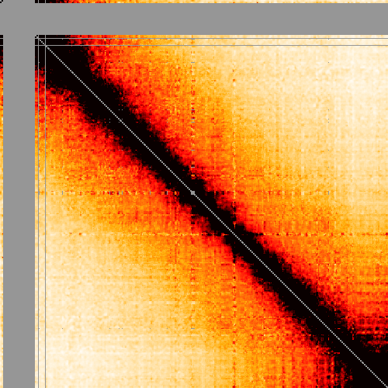
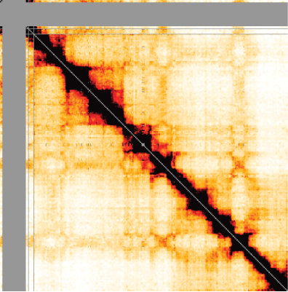
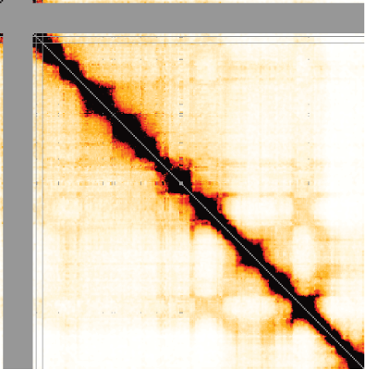
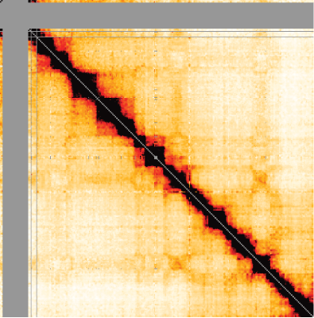
Chromosome folding dynamics during the cell cycle
M
Early G1
V
S
Mid G1
Naumova, Imakaev, Fudenberg et al. Science (2013)
Notes:
Initially studied the small chromosome 21 over the cell cycle with a variant of Hi-C, since this allows looking with greater detail for a lower cost of sequencing.

Slide 12
How to process Hi-C data
align
bwa mem
Pipeline
bwa – map paired-end reads
pairsamtools – parse mapping output, classify and filter pairs
cooler – aggregate pairs into contact matrices and normalize
Distiller:
nextflow-based scalable and reproducible implementation
classify
pairsamtools
sort + dedup
pairsamtools
filter + bin
cooler
balance
cooler

Slide 13
align
Align paired end reads to the reference assembly
Historically, this was done using iterative global alignment
Today, the more common approach is to use an efficient local alignment algorithm (e.g., bwa-mem)
classify
sort + dedup
filter + bin
More efficient
More sensitive
Ambiguous chimeric alignments can be further processed to detect multi-point ligation events (a.k.a. C-walks)
balance

Slide 14
align
form Hi-C pairs by reporting the outer-most mapped positions and the strand on the either side of each molecule
find and rescue chimeric alignments produced by Hi-C molecules having a sequenced ligation junction on one of the sides
make pair records upper-triangular by flipping of the sides of Hi-C molecules such that the first side has a lower sorting index than the second side
classify
sort + dedup
filter + bin
balance

Slide 15
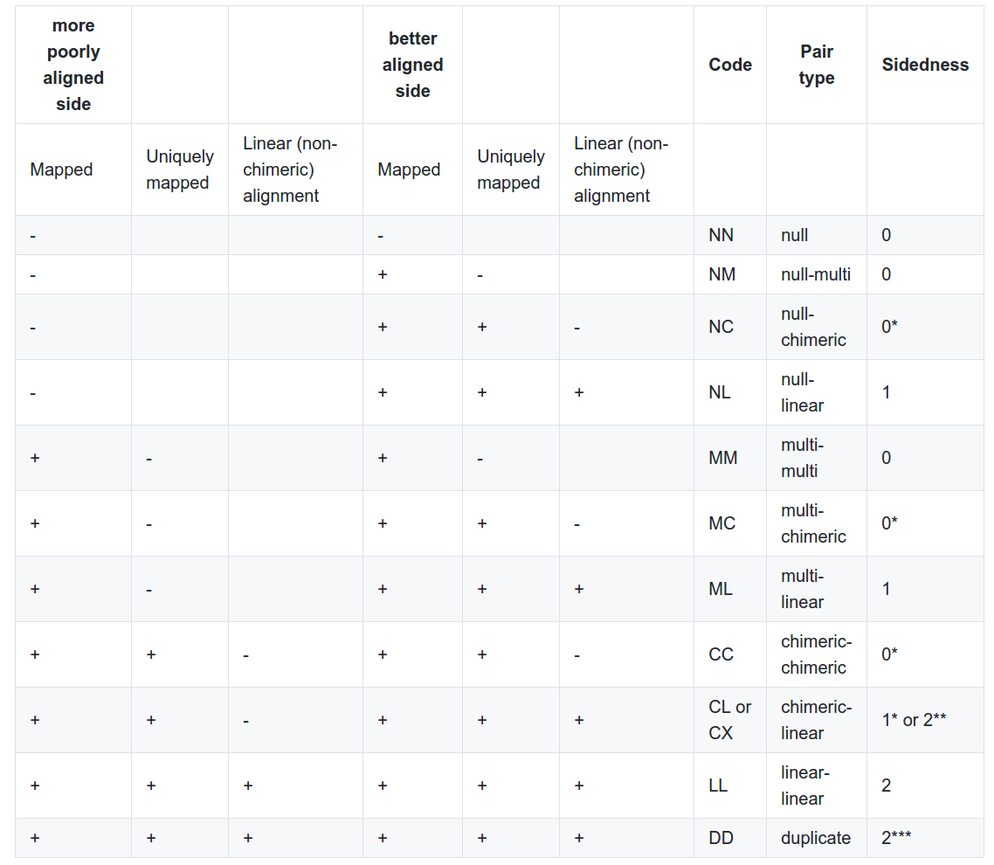
align
classify
sort + dedup
filter + bin
balance
Unambiguous pairs:
LL + CX

Slide 16
Chromosome order matters!
chr1
chr2
chr3
chr4
chr5
…
align
In contact lists, contact records should reflect a given chromosome order so that contacts lie exclusively in the upper triangle of the map tiled using that chromosome order.
classify
sort + dedup
filter + bin
chrom1, pos1, chrom2, pos2, …
balance

Slide 17
align
remove PCR duplicates by finding pairs of entries with both sides mapped to similar genomic locations (+/- N bp)
optionally output the PCR duplicate entries into a separate file for QC
classify
sort + dedup
filter + bin
balance

Slide 18
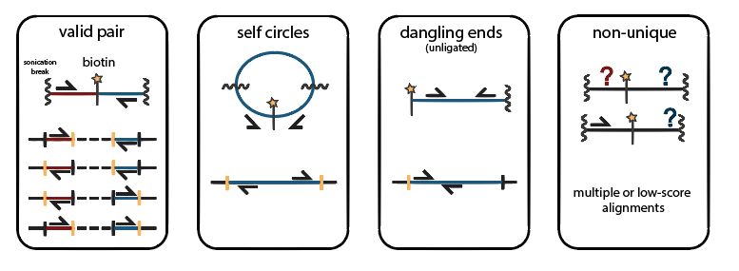
Genomic proximity and informative ligation products
align
classify
sort + dedup
filter + bin
balance

Slide 19
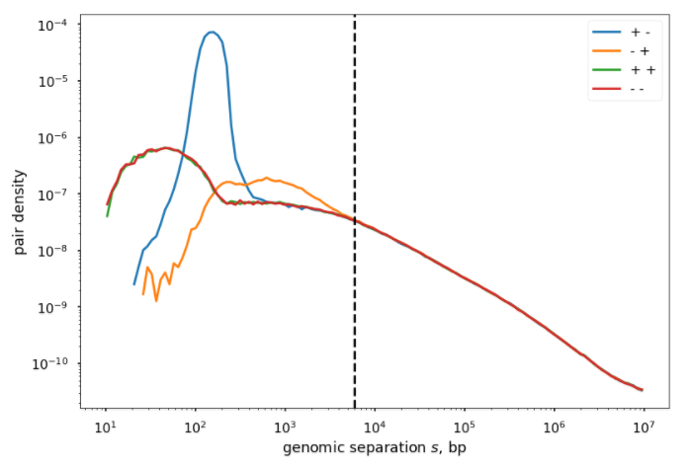
Genomic proximity and informative ligation products
align
Enriched in dangling ends
classify
Enriched in self circles
sort + dedup
filter + bin
balance

Slide 20
Proximity filtering
Filter pairs within fragments
Remove/ignore diagonals
Bin quality filtering
Bins with poor coverage
Cutoff on row sum, nnz
Truncate the tails of the row sum distribution (MAD-max)
Other artifacts
SVs, translocations
Can be done before or after binning
align
classify
sort + dedup
filter + bin
balance

Slide 21
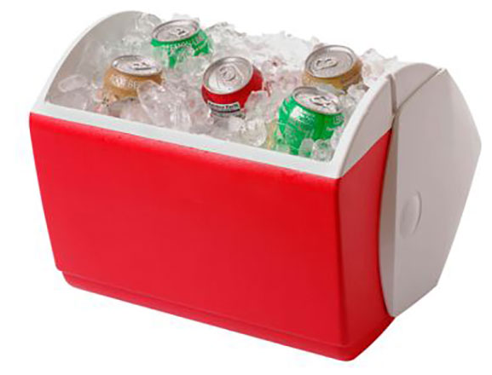
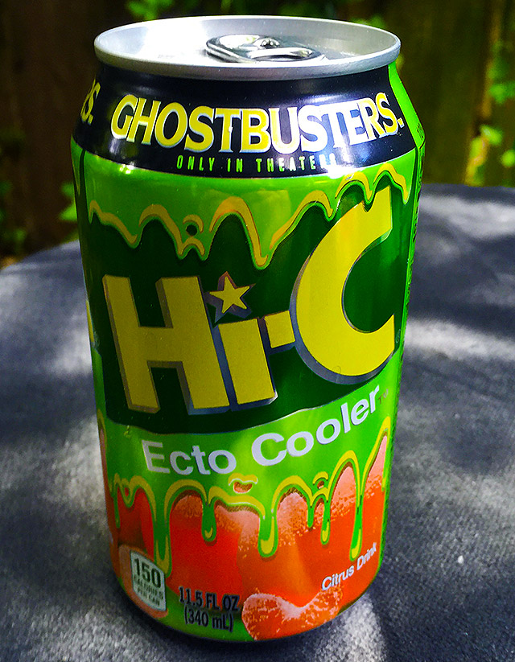
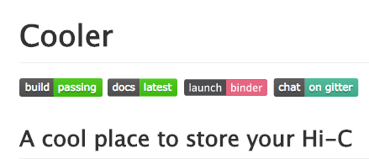
align
classify
sort + dedup
filter + bin
balance

Slide 22
Cooler
Sparse, binary, columnar, compressed storage schema based on HDF5 (.cool)
Python support library and CLI provides tools to create, aggregate, query, and normalize coolers
Provides sparse, parallel, out-of-core matrix balancing
Aims to integrate smoothly with the Python data ecosystem: numpy, pandas, dask, jupyter
align
classify
sort + dedup
filter + bin
balance

Slide 23
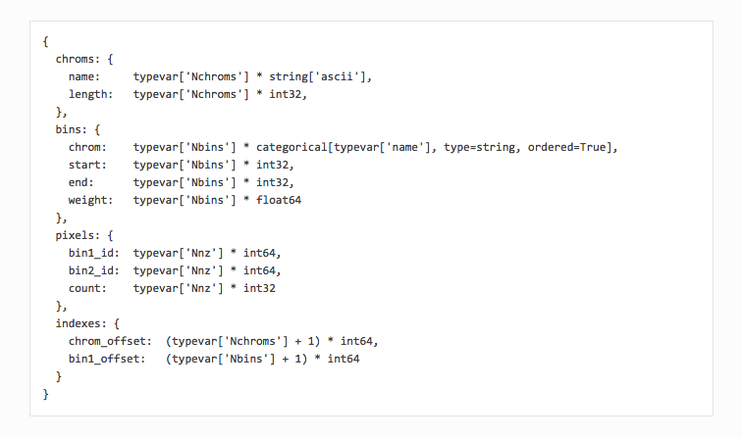
align
classify
sort + dedup
filter + bin
balance

Slide 24
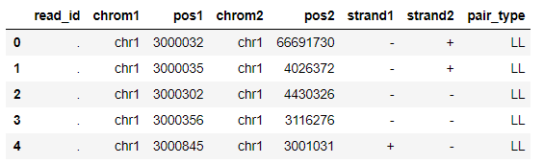
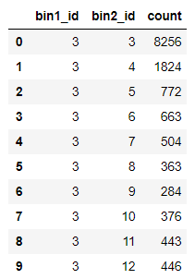
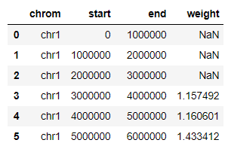
pairs
align
classify
aggregate
(nonzero) pixels
bins
sort + dedup
filter + bin
+
balance

Slide 25
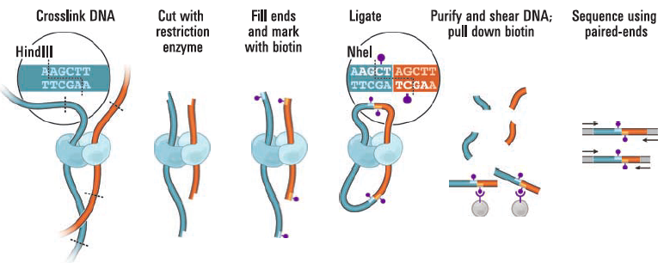
3C/Hi-C sources of bias
Ligation efficiency as a
function of fragment length
Digestion efficiency as a
function of sequence composition
(and DNA compaction)
Sequencing efficiency as a
function of sequence composition

Slide 26
Hi-C normalization
Explicit factor methods
Yaffe-Tanay method (Yaffe et al, 2011)
HiCNorm (Ren lab)
Matrix balancing
Iterative correction (Imakaev et al, 2011)
Knight-Ruiz (Rao et al, 2014)
Can be applied to whole genome, cis maps, or other subsets

Slide 27
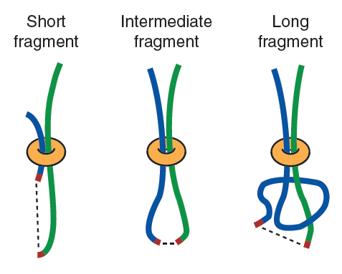
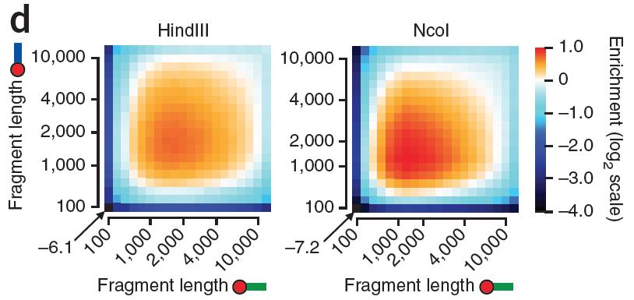
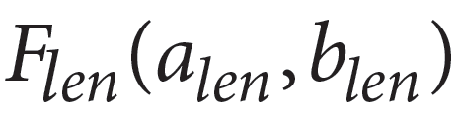
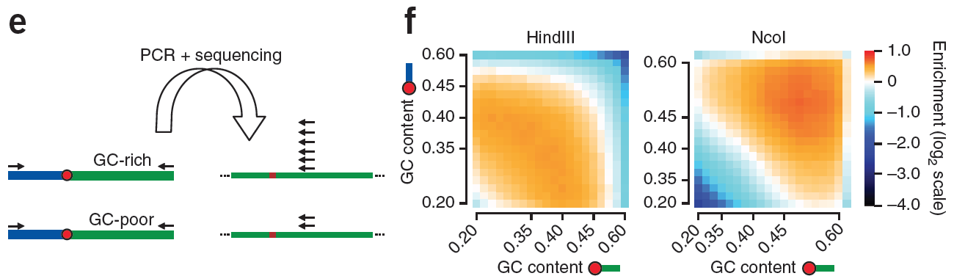
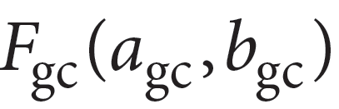



Explicit bias correction
Fragment length influences ligation efficiency
Model:
G/C-content influences amplification and sequencing efficiency
Model:
Sequence uniqueness determines mappability
Model:
Yaffe & Tanay, Nat. Genetics (2011)

Slide 28



Matrix balancing (iterative correction)
Alternatively, don’t explicitly model sources of bias
Only assume:
biases are multiplicative
total relative contact probabilities for each bin should sum to 1
Solution: Iterative correction algorithm
a.k.a. Proportional fitting
a.k.a.
Matrix balancing
Algorithms that solve the same problem go by various names:
Sinkhorn-Knapp
Knight-Ruiz
Imakaev et al., Nature Methods (2012)

Slide 29
align
classify
http://bit.ly/2uHd98l
sort + dedup
filter + bin
balance

Slide 30
Distiller pipeline: .fastq -> .pairs + .bam -> .cool
Parse .bam
into Hi-C pairs
(.pairsam)
Map .fastq
(bwa mem -SP)
Merge runs into libraries
Make
DCIC .pairs
and
.bam with Hi-C information
Set aside unmapped
/multimapped
/chimeras
[/random breaks]
/PCR duplicates (+/- N bp)
Make binned
matrices (.cool)
for libraries
and library groups

Slide 31
Distiller data flow example
runs
libraries
library groups
lane1
pairsam
fastq
SRA
lane2
WT-HindIII-R1
lane3
WT-HindIII-all
...
.bam
.pairs
.bam
.cool
.stats
.cool
.stats

Slide 32
Distiller data flow
runs
libraries
library groups
lane1
pairsam
input
lane2
WT-HindIII-R1
lane3
WT-HindIII-all
lane1
input
WT-HindIII-R2
lane2
lane3
WT-all
input
lane1
lane2
WT-MboI-R1
sam/bam
lane3
pairs
fastq
SRA
coolers
products
products
products
stats

Slide 33
Analyzing Hi-C data

Slide 34


Feature assessment

Slide 35
Feature assessment

Slide 36







Compartments
~1-10Mb
/
=
Eigendecomposition identifies two global types of regions:
Type A:
- open chromatin
- gene rich
- (active) chromatin marks
Type B:
- closed chromatin
- gene poor
Both types are primarily self-interacting
chromosome 4
log₂(lamina association)
LADs
chromosomal position (Mb)

Slide 37

Feature assessment

Slide 38



Domains, insulation, TADs
~0.1-1Mb
There are also 2D scoring functions based on dynamic programming, hierarchical domain callers, and more!
http://bit.ly/2vpeqP3
Based on 1D scoring functions, assessing insulation properties

Slide 39


Hi-C based domain architecture is also largely conserved across species
Dixon et al 2012, Nature

Slide 40

Hi-C-based domain architecture is also largely conserved across cell types
Dixon et al 2015, Nature

Slide 41


Formation of domains by loop extrusion
Riggs (1990) - DNA reeling
Blackwood and Kadonaga (1998) - Facilitated tracking
Nasmyth (2001) - Loop expansion
Alipour and Marko (2012) - Loop extrusion model
Goloborodko, Marko and Mirny (2016)
metaphase
Interphase:
Fudenberg et al., 2016, Cell Reports 15, 2038–2049
Notes:
Fudenberg et al., 2016, Cell Reports 15, 2038–2049

Slide 42



Prediction: depletion of CTCF & cohesin would both dissolve TADs, but in very distinct fashions

Slide 43
Acknowledgments
Mirny Lab
Maxim Imakaev
Geoff Fudenberg (now UCSC)
Anton Goloborodko
Dekker Lab
Bryan Lajoie (now Illumina)
Noam Kaplan (now Technion)
Hakan Ozadam
Sergey Venev
Ankita Nand
Gehlenborg Lab @ HMS-DBMI
Fritz Lekschas
Scott Oullette
4DN-DCIC and Park Lab @ HMS-DMBI
Burak Alver
Carl Vitzthum

Slide 45
Ligation products

Slide 46
Hi-C molecule types
* chimeric reads may represent Hi-C molecules formed via multiple ligation events and thus cannot be interpreted as unambiguous pairs.
** some chimeric reads correspond to valid Hi-C molecules formed via a single ligation event, with the ligation junction sequenced through on one side. Following Juicer’s procedure, pairsamtools rescue such molecules, report their outer-most mapped positions and tag them as "CX" pair type. Such molecules can and should be used in downstream analysis.
*** pairsamtools detect molecules that could be formed via PCR duplication and tags them as "DD" pair type. These pairs should be excluded from downstream analyses.

